Slide 1

Data Structures
Lecture: Graph
By
Nitish Kumar
Asst. Professor
Lovely Professional University, Punjab

Slide 2
Contents
Introduction
Basic Terminology
Sequential Representation of Graphs
  Adjacency Matrix
  Path Matrix
Linked Representation of Graphs
Warshall’s Algorithm: Shortest Path
Review Questions

Slide 3
Introduction
A Graph G is a collection of:
A set V of elements called Nodes or Vertices.
A set E of Edges such that each edge e in E is identified with a unique pair [u, v] of nodes in V, denoted by e = [u, v].
G = (V, E)
Nodes u and v are called end points of edge e and also known as adjacent nodes or neighbors.

Slide 4
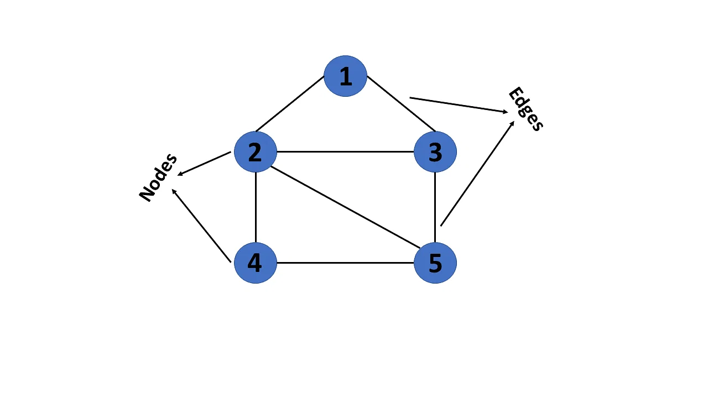
Graphs
A graph is a non-linear kind of data structure made up of nodes or vertices and edges. The edges connect any two nodes in the graph, and the nodes are also known as vertices.

Slide 5
Basic Terminology
Degree of a node: Degree of a node, deg(u), is the number of edges containing u.
If deg(u) = 0, then node u is called Isolated Node.
A Path P of length n from node u to a node v is defined as a sequence of n+1 nodes.
P = (v₀, v₁, v₂,...,v_{n})

Slide 6
Basic Terminology
Simple Path: The path is said to be simple is all the nodes are distinct.
Closed Path: A path is said to be closed if first and last node are same i.e. v0 = vn.
Cycle: A cycle is a closed simple path with length 3 or more.
A cycle with length k is called k-cycle.

Slide 7
Graph
Connected Graph: A graph G is connected iff there is a simple path between any two nodes in G.
Complete Graph: A graph G is said to be complete if every node u in G is adjacent to every other node v in G. i.e. each node u is directly connected to all other nodes v in Graph G.
A complete graph with n nodes will have n(n-1)/2 edges.

Slide 8
Labeled Graphs...
A graph G is said to be labeled if its edges are assigned data.
Weighted Graph: Graph G is said to be weighted if each edge e is assigned a non-negative numerical value w(e) called the weight or length of edge.
If no other information about weights are given in a graph, then assume the weight w(e) = 1 for each edge.

Slide 9
Multi-Graph
Multiple Edges: Distinct edges e and e’ are called multiple edges if they connect the same endpoints,
i.e. if e = [u, v] and e’ = [u, v].
Loops: An edge e is called a loop if it has identical endpoints ,
i.e. if e = [u, u] .
Note: Definition of a graph does not allow any loop or multiple edge in Graph.
A Graph with loops or multiple edges is called a Multi-graph.

Slide 10
Directed-Graph
A Directed-graph G, also called Digraph or Graph, is same as the multigraph except that each edge e in G is assigned a direction i.e. each edge e is identified by an ordered pair (u, v ) of nodes in G, rather than an unorderd pair [u, v].
Teminology:
Edge e = (u, v) is called an Arc.
  e begins at u and ends at v.
  u is called origin and v is called destination.
  u is adjacent to v and v is not adjacent to u.
  u is predecessor of v and v is sucessor of u.

Slide 11
Degree of Graph
Outdegree: Outdegree of a node u in G is the number of edges beginning at u.
Indegree: Indegree of a node u in G is the number of edges ending at u.
Source: A node u is called a source if it has a positive outdegree but zero indegree.
Sink: A node u is called a sink if it has a positive indegree but zero outdegree.

Slide 12
Sequential Representation
There are two ways of representing a graph in memory:
  Sequential Representation
    Adjacency Matrix
    Path Matrix
  Linked Representation

Slide 13
Adjacency Matrix
Let G is a simple directed graph with m nodes and the nodes of G have been ordered and are called v1, v2, ..., v_{m}.
The adjacency matrix A = a_{ij} of graph G is the m×m matrix defined as below:
a_{ij} = 1, if vi is adjacent to v_{j}, i.e. if there is an edge (v_{i}, v_{j})
a_{ij} = 0, otherwise
Suppose G is an undirected graph, then the adjacency matrix A of G will be a symmetric matrix i.e. one in which a_{ij} = a_{ji}.

Slide 14
Adjacency Matrix
Let A be the adjacency matrix of a graph G. Then AK(i, j), the ij entry in the matrix AK, gives the number of paths of length K from v_{i} to v_{j}.

Slide 15
Path Matrix
Let G is a simple directed graph with m nodes v1, v2, ..., vm.
The Path matrix or Reachability matrix P = p_{ij} of graph G is the m×m matrix defined as below:
p_{ij} = 1, if there is a path from vi to vj
p_{ij} = 0, otherwise

Slide 16
Path Matrix
Let A be the adjacency matrix and P be the path matrix of a diagraph G. Then P_{ij} = 1, iff there is a non-zero number in the ij entry of the matrix
B_{m} = A + A² + A³ +...+A^{m}
Path matrix is obtained by replacing the non-zero entries in B_{m} by 1.
Graph G is strongly connected iff path matrix P of G has no zero entries.

Slide 17
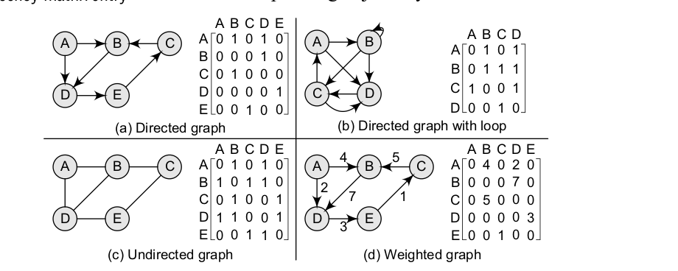

Slide 18
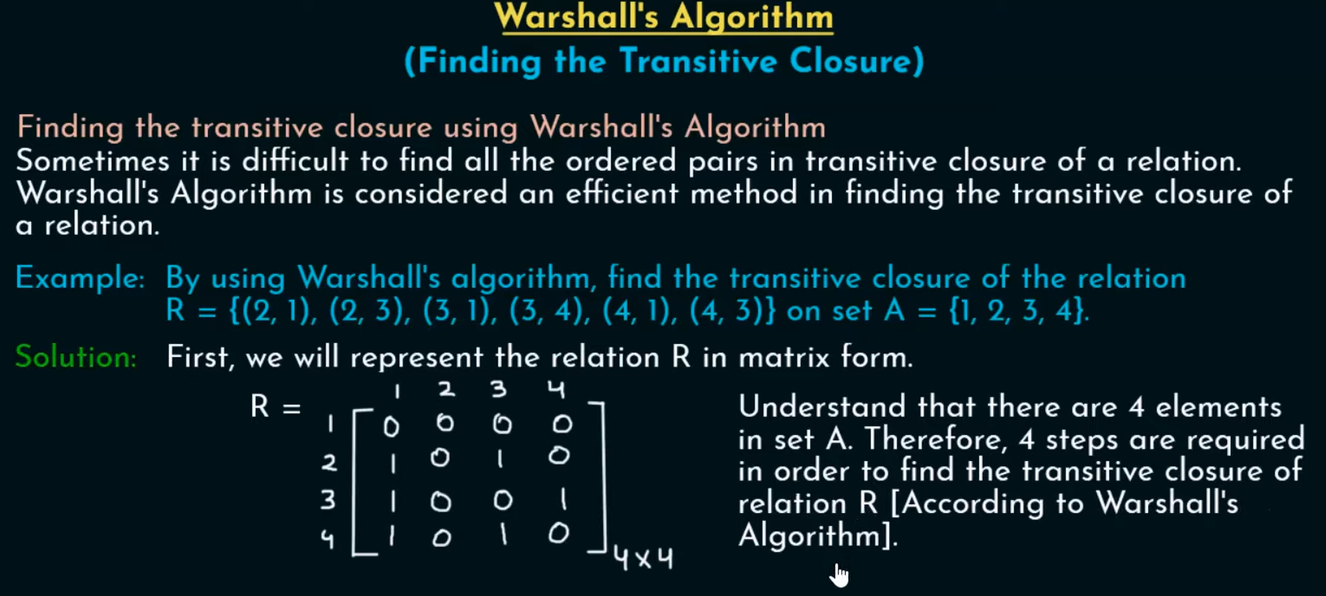

Slide 19
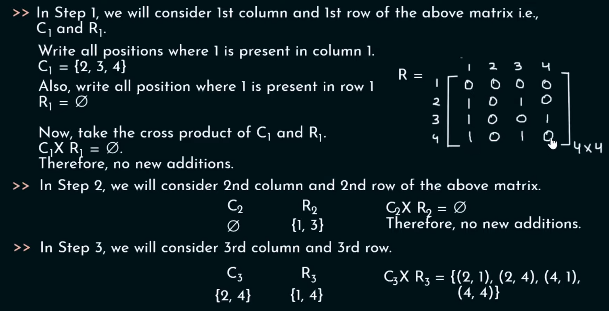

Slide 20
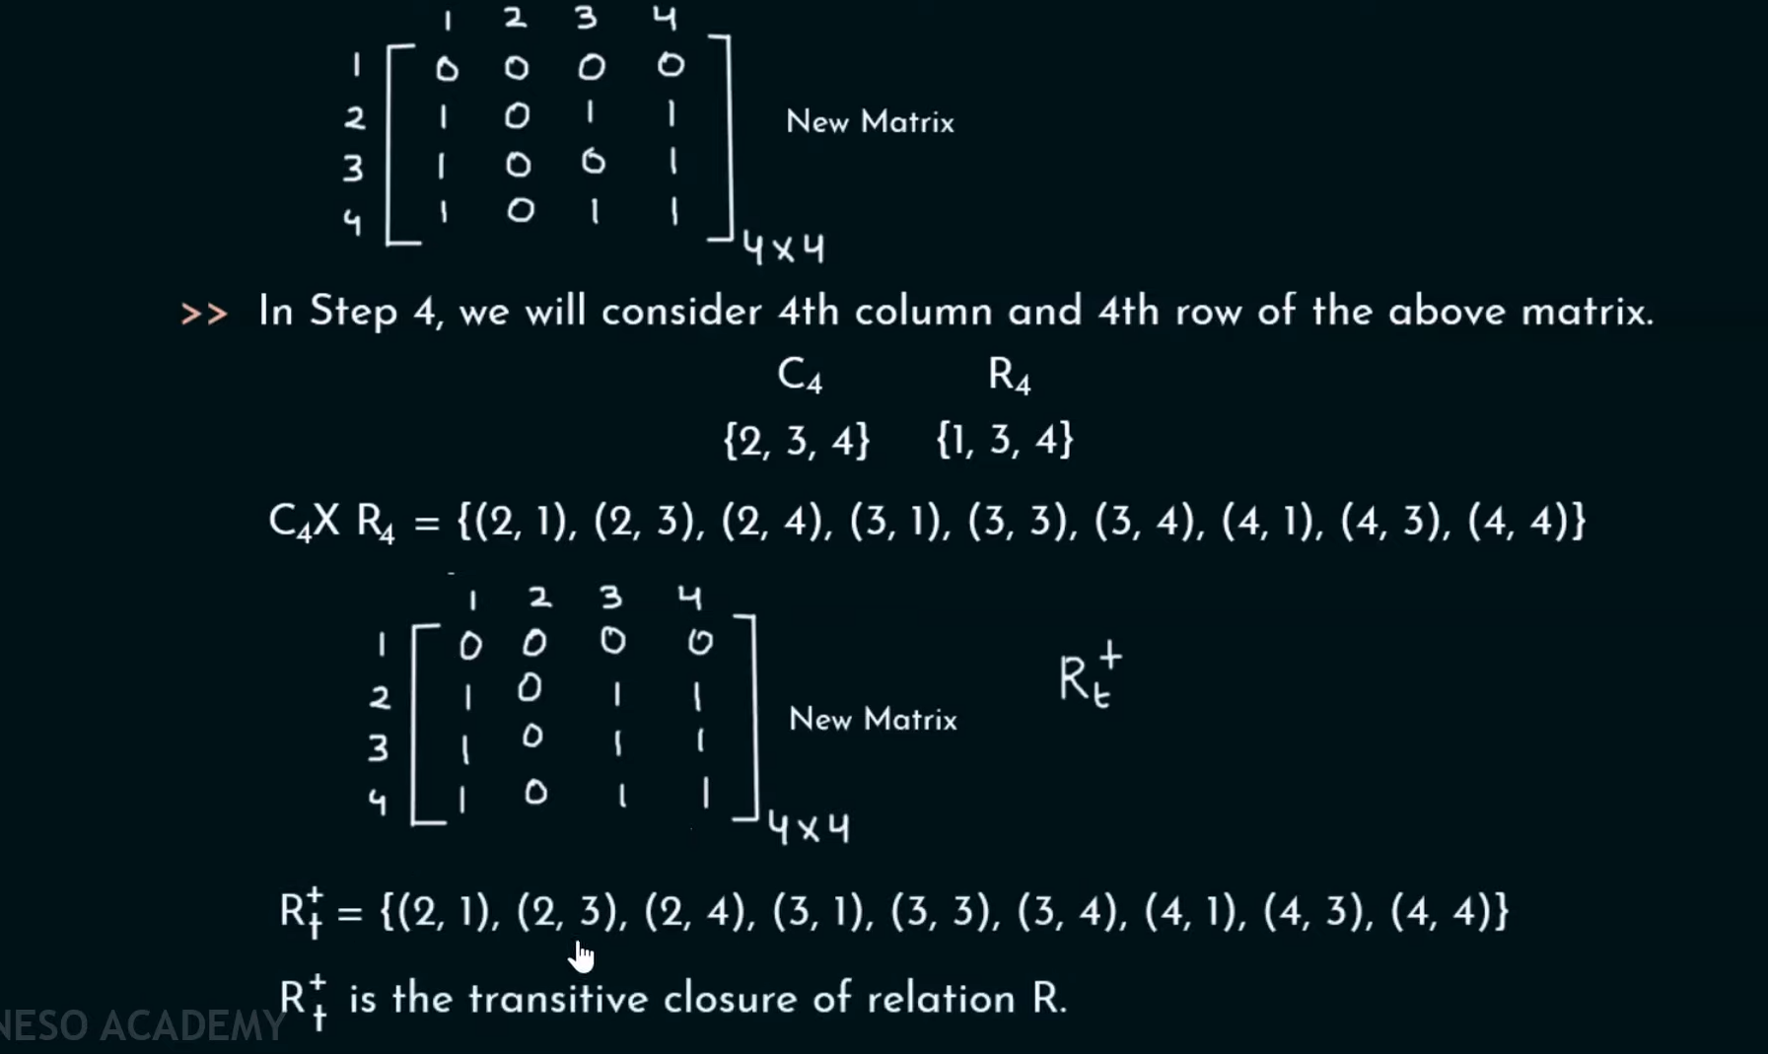

Slide 21
Floyd Warshall Algorithm
The Floyd-Warshall algorithm is a graph algorithm that is deployed to find the shortest path between all the vertices present in a weighted graph.
Floyd Warshall Algorithm is a famous algorithm:
It is used to solve All Pairs Shortest Path Problem.
It computes the shortest path between every pair of vertices of the given graph.
Floyd Warshall Algorithm is an example of dynamic programming approach.
Floyd-Warshall algorithm works on both directed and undirected weighted graphs unless these graphs do not contain any negative cycles in them. By negative cycles, it is meant that the sum of all the edges in the graph must not lead to a negative number.

Slide 22
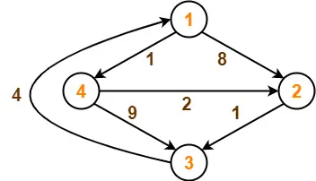
Floyd Warshall Algorithm

Slide 23
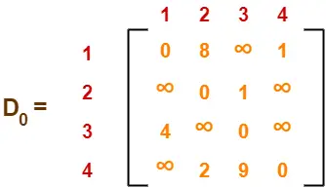
Step-01:
Remove all the self loops and parallel edges (keeping the lowest weight edge) from the graph.
Step-02:
Write the initial distance matrix.
It represents the distance between every pair of vertices in the form of given weights.
For diagonal elements (representing self-loops), distance value = 0.
For vertices having a direct edge between them, distance value = weight of that edge.
For vertices having no direct edge between them, distance value = ∞.

Slide 24
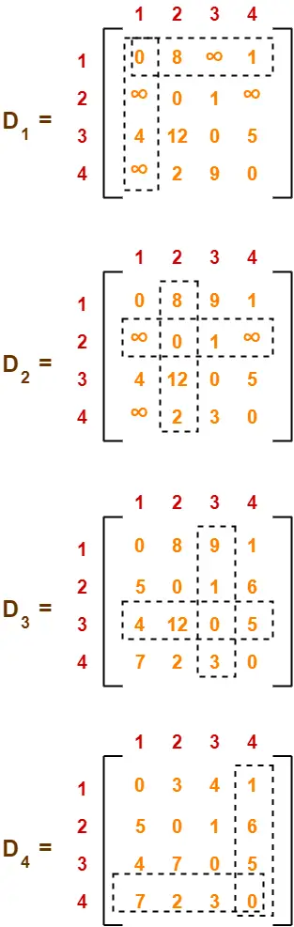

Slide 25
Floyd Warshall Algorithm
Create a |V| x |V| matrix // It represents the distance between every pair of vertices as given
For each cell (i,j) in M do-
if i = = j
M[ i ][ j ] = 0 // For all diagonal elements, value = 0
if (i , j) is an edge in E
M[ i ][ j ] = weight(i,j) // If there exists a direct edge between the vertices, value = weight of edge
else
M[ i ][ j ] = infinity // If there is no direct edge between the vertices, value = ∞
for k from 1 to |V|
for i from 1 to |V|
for j from 1 to |V|
if M[ i ][ j ] > M[ i ][ k ] + M[ k ][ j ]
M[ i ][ j ] = M[ i ][ k ] + M[ k ][ j ]

Slide 26
Warshall’s Algorithm
Path Matrix
Repeat for I = 1 to M
Repeat for J =1 to M
If A[I,J] = 0 then
Set P[I, J] = 0
Else
Set P[I, J] = 1
2. Repeat for K = 1 to M
Repeat for I = 1 to M
Repeat for J =1 to M
Set P[I, J] = P[I, J] V (P[I, K] ᴧ P[K, J])
3. Exit

Slide 27

Questions

